Slide 1


The API User Experience
Presented at
{API: World} 2018
San Jose, CA
Michael Irigoyen
Senior Software Engineer mirigoyen@accusoft.com
goyney
mririgo

Slide 2

About Me
I am Michael Irigoyen.
UI/UX design for 15+ years
PHP for 13+ years
JS for 10+ years
Node.js for 3+ years

Slide 3
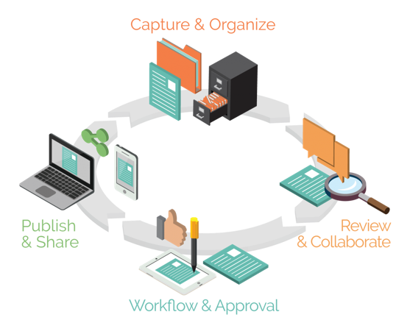
About Accusoft
Solving document lifecycle complexities with products built for developers.
Located in Tampa, FL
Founded in 1991
Awarded 30+ U.S. Patents
Creates powerful Imaging SDKs
Provides RESTful APIs for Document and Image processing

Slide 4
What is an API?
An API, or Applications Programming Interface,
is a software intermediary that allows
two applications to talk to each other.

Slide 5
What is an API?
An API, or Applications Programming Interface,
is a software intermediary that allows
a developer (usually a human being) to program
two applications to talk to each other.

Slide 6
Why aren’t developers using our API?
Why aren’t people using our product?
Notes:
Commonly asked question, “Why aren’t people using our API?” Depending on the type of product you’re creating, may naturally lead to “Why aren’t people using our product?”

Slide 7

Complexities in API Consumption
Non-standard interfaces
Poor (or lack of) versioning
Return data models inconsistent
Redundant requests for simple tasks
Notes:
Examples:
Non-standard interfaces - Incorrect usage of HTTP verbs, varying URIs, etc.
Poor or lack of versioning - Changes to endpoints breaks current implementations
Return data models inconsistent - Multiple formats (JSON, XML, plaintext), JSON examples: arrays vs. objects, inconsistent variables names, etc.
Too many requests - One HEAD request to get IDs of many resources, force a single GET request for each resource for more details, etc.

Slide 8
Complexities in API Consumption
Non-standard interfaces
Poor (or lack of) versioning
Return data models inconsistent
Redundant requests for simple tasks
Bad documentation
Notes:
Examples:
Non-standard interfaces - Incorrect usage of HTTP verbs, varying URIs, etc.
Poor or lack of versioning - Changes to endpoints breaks current implementations
Return data models inconsistent - Multiple formats (JSON, XML, plaintext), JSON examples: arrays vs. objects, inconsistent variables names, etc.
Too many requests - One HEAD request to get IDs of many resources, force a single GET request for each resource for more details, etc.

Slide 9
“People ignore design that ignores people.”
Frank Chimero
Author, “The Shape of Design”
“If the user can’t use it, it doesn’t work.”
Susan Dray, Ph.D.
Usability Professionals’ Association
“Focus unswervingly on the customer.”
Jesse Hertzberg
Former COO, Squarespace
“You’re designing a product for people...”
Joey Flynn
Product Designer, Facebook
Notes:
All those complexities lead to one thing… The developer’s relationship with your API.

Slide 10
User Experience (UX)
UX is defined as “a person's perceptions and responses that result from the use or anticipated use of a product, system or service". ^{- ISO 9241-210}
UX does not apply only to user interfaces!
UX aims to enhance the customer experience
Improve usability
Create ease of access
Promote satisfaction
Notes:
UX is typically thought of to be exclusive to the user interface

Slide 11
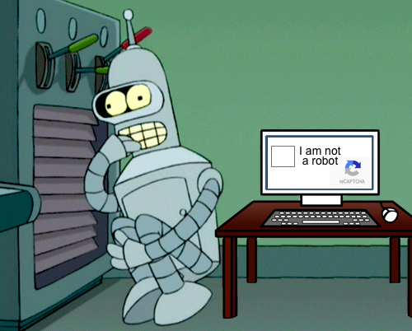
Design Your API for Humans
Throw away the notion of building something for a computer to consume
Humans are the ones integrating your API
Determine what your users need to successfully and easily implement your interface

Slide 12
User Experience Honeycomb
useful
usable
desirable
valuable
findable
accessible
credible
- Peter Morville
Notes:
Created by Peter Morville, these 7 categories are what users are looking to get out of a product, system, or service. It’s important to strive to satisfy each category when designing and implementing an API.

Slide 13
As a consumer of your API, I want it to...
Provide functionality I need
Be well-documented and easy-to-use
Have an easy path to get support
Have organized and manageable output
Be secure
Be consistent

Slide 14
User Experience Honeycomb
useful
usable
desirable
valuable
findable
accessible
credible
- Peter Morville
Notes:
Created by Peter Morville, these 7 categories are what users are looking to get out of a product, system, or service. It’s important to strive to satisfy each category when designing and implementing an API.

Slide 15
User Experience Honeycomb
Provides functionality I need
useful
usable
desirable
valuable
findable
accessible
credible

Slide 16
User Experience Honeycomb
Provides functionality I need
Well documented and easy-to-use
useful
usable
desirable
valuable
findable
accessible
credible

Slide 17
User Experience Honeycomb
Provides functionality I need
Well documented and easy-to-use
useful
usable
desirable
Easy path to get support
valuable
findable
accessible
credible

Slide 18
User Experience Honeycomb
Provides functionality I need
Well documented and easy-to-use
useful
usable
desirable
Easy path to get support
valuable
Output is organized and manageable
findable
accessible
credible

Slide 19
User Experience Honeycomb
Provides functionality I need
Well documented and easy-to-use
useful
usable
desirable
Easy path to get support
valuable
Output is organized and manageable
findable
accessible
credible
Interface is secure and has a legitimate URI

Slide 20
User Experience Honeycomb
Provides functionality I need
Well documented and easy-to-use
useful
usable
desirable
Easy path to get support
valuable
Output is organized and manageable
findable
accessible
credible
Consistent, versioned interface
Interface is secure and has a legitimate URI

Slide 21
User Experience Honeycomb
Provides functionality I need
Well documented and easy-to-use
useful
usable
desirable
Easy path to get support
valuable
Output is organized and manageable
findable
accessible
credible
Consistent, versioned interface
Interface is secure and has a legitimate URI

Slide 22
Complexities in API Consumption
Non-standard interfaces
Poor (or lack of) versioning
Return data models inconsistent
Redundant requests for simple tasks
Bad documentation
Notes:
Jumping back here to take another look the complexities introduced earlier, mainly to focus now on documentation.

Slide 23
Non-standard interfaces
If following a standard (i.e. REST, SOAP, etc.) take care to understand and implement according to the standard
If creating your own interface, take the extra time to design and forward-think
Create patterns that aren’t too specific but are also not so generic that they are easy to confuse
Consider using object based parameters for future extendibility
Keep all interfaces consistent

Slide 24
Poor (or lack of) versioning
Always version your API, even if you never plan or intend to make backwards-incompatible changes
Plan a versioning scheme in your design and stick with it
Try to keep all interface versions consistent
Harder to manage for the consumer of the API
Version your documentation with your API

Slide 25
Return data models
Stick to JSON or XML
These are the most common and easiest for your API consumer to pick up and use
Try not to intermix; pick the least common denominator
If you need to be more specific, XML tends to be the best choice
JSON is lightweight and can be consumed naturally by other JavaScript-based applications

Slide 26
Redundant requests for simple tasks
Design your interfaces so that a task can be done in the fewest requests as possible
Don’t break separation of concerns
Support handling bulk requests
Handle pagination of large datasets
Consider creating SDKs for your REST interfaces

Slide 27
Complexities in API Consumption
Non-standard interfaces
Poor (or lack of) versioning
Return data models inconsistent
Redundant requests for simple tasks
Bad documentation
Notes:
Checking in on Alan: he still is confused. Take another look the complexities introduced earlier, mainly to focus now on documentation.

Slide 28
Complexities in API Consumption
Non-standard interfaces
Poor (or lack of) versioning
Return data models inconsistent
Redundant requests for simple tasks
Bad documentation
Notes:
Highlight bad documentation as being one of the biggest sticking points in API user experience.

Slide 29
— SWEEPING DECLARATION —
Documentation is the
most important
component of your API
Notes:
It is also the most commonly skipped or neglected, especially from the onset.

Slide 30


API Documentation
useful
Regardless of how the API is implemented, without proper documentation, you are deterring, and quite possibly even preventing, users from utilizing your interface
No two APIs are the same, don’t force your consumer to assume anything
usable
desirable
valuable
findable
accessible
credible

Slide 31
Think Documentation Early and Often
When creating a new API, include a documentation plan as part of your API design
What needs to be documented?
Who is your target audience?
Who will write it?
Where will it be stored?
How will it be generated for users?
Start looking for missing or weak points in your current APIs for places that can benefit from documentation

Slide 32
Documentation Is Important For Developers, Too!
While we’re mostly focused on the User Experience, think about the experience of your developers as well
Document private interfaces the same way you document public ones
Practice makes perfect!
Helps with onboarding new developers
Work is already done if you decide to make the interface public in the future

Slide 33
Provide an Intuitive Documentation Site
Open-source libraries handle most of the UI work so you can focus on writing good documentation
Create a Getting Started section
Introduce the fundamentals to your API at a high-level
Don’t forget about search!
Provide easy ways for your users to get further help and/or submit feedback

Slide 34

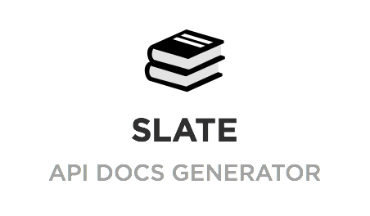



Provide an Intuitive Documentation Site
Lots of good open-source tools available
api blueprint
Docusaurus

Slide 35
Break the first barrier: Authentication
Authentication can be, and likely is, the most complex portion of any API
Break it out into its own section and make sure it is easily findable (right after Getting Started)
Elaborate on all authentication models you support and provide detailed code examples

Slide 36
Code samples are king
Interactive code samples are rapidly growing in popularity
Allows customers to get a feel for your API before ever integrating it
Consider using tools, like Postman, to offer collections of your API
Copy-paste code blocks makes getting started quick

Slide 37
Track Analytics on Your Docs (and APIs too!)
Analytics can help you focus on popular or problematic areas of your documentation
Look for patterns in errors against an interface versus the number of people looking at the docs for that interface
Add links for code samples to languages you don’t have examples for and watch the data to make decisions
Be data driven!

Slide 38
Real-World: APIs at Accusoft
APIs for Barcode Recognition, OCR, Image & Form Processing
Expose SDKs in their respective language
PrizmDoc Products for Document Viewing, Editing, Redacting, Conversion, E-Signature, etc.
Expose RESTful APIs
Biggest area we’re working to improve is documentation

Slide 39
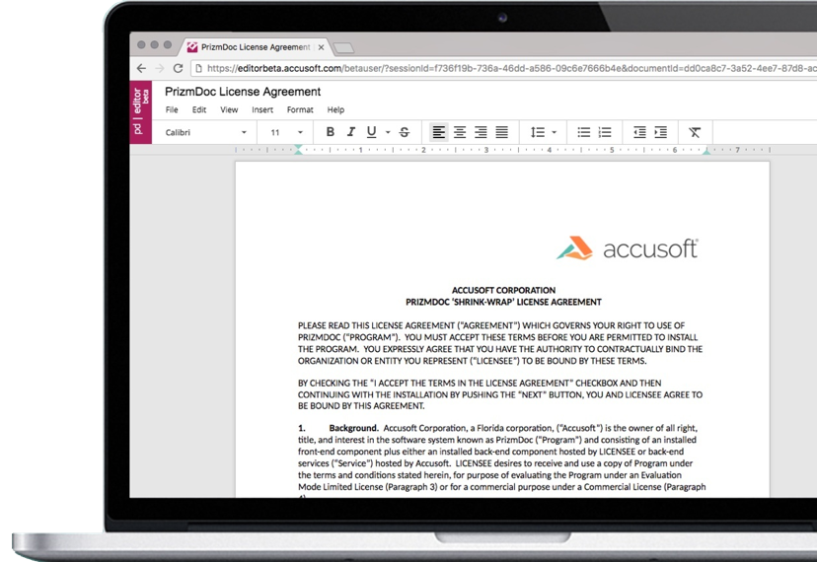
Real-World: APIs at Accusoft
Working to improve consistency on existing documentation
Currently implementing documentation on our newest product, PrizmDoc Editor
Planning SDKs in common languages that wrap our RESTful APIs to reduce integration complexity

Slide 40
Summary
Reduce or remove any barriers that prevent your customers from getting started and moving quickly
Build a documentation strategy for your product or company and stick with it
Be data driven!
Always be thinking about the customer’s experience

Slide 42
mirigoyen@accusoft.com
goyney
mririgo

